Slide 1
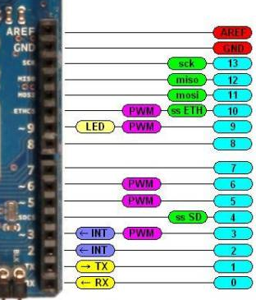

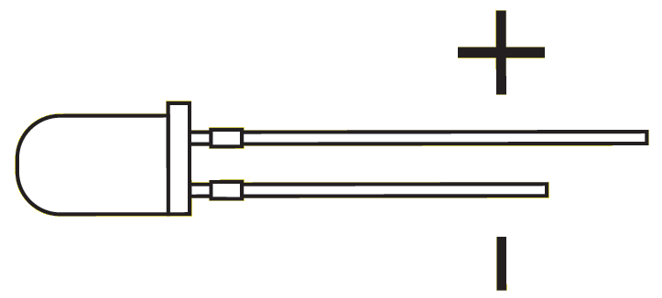
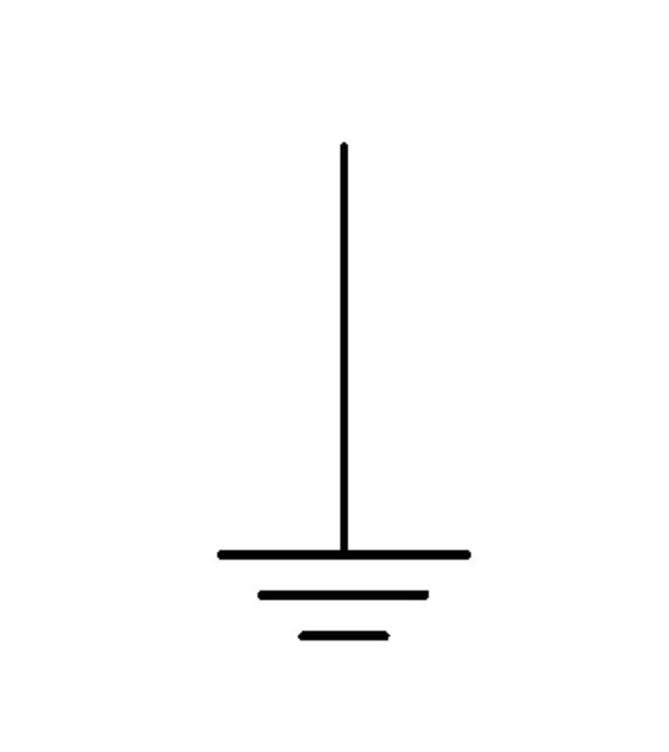
Experiment On
Vdd
Start/Stop Experiment
100Ω
Response Button Pressed
470Ω
470Ω
Vdd
Response Button
100Ω
100Ω
Stimulus

